Slide 1
Next up:
Justin Grote – Azure Functions
Notes:
Dear speaker,
your session will be recorded and published (unless otherwise agreed).
Please ensure that:
Your screen resolution is set to 1920x1080 pixels.
Your device should have a (full size) HDMI output. You're welcome to bring a proper dongle for your device, if this connection is missing.
Your device must not provide protected output such as HDCP (especially important for MAC users).
Start the countdown (slides 2-4) IMMEDIATELY BEFORE you talk to the audience!
The countdown is important in terms of video editing after the conference. The published session will start with slide 5. Feel free to remove slide 1-4 before you upload the slides to the conference repository.
Good luck! 💙

Slide 2
3
Notes:
[REQUIRED SLIDE]

Slide 3
2
Notes:
[REQUIRED SLIDE]

Slide 4
1
Notes:
[REQUIRED SLIDE]

Slide 5
Azure Functions: The Missing Manual
Justin Grote

Slide 6

Many thanks to our sponsors:

Slide 7

About Allied Digital
Why ADSL?
Core capabilities
Partner to 10 out of Fortune 100
Operating in 70 countries
Delivering complex sustainable projects
Digital Business Transformation DNA
Sound Financials
Consistent growth, QoQ, YoY
Cloud Transformation, DevOps and Engineering
Enterprise Infrastructure Management Services
Systems Integration – IoT, Smart Cities
CyberSecurity Services and Solutions
Service Management Platform, Automation, Mobility
Modern Workplace (End User) Services and Solutions
Differentiators
Awards & Accolades
Outcome based service model
Strategic 360 degree Industry partnerships
Wide spectrum of Technology Skills
Large contract capability, over USD 100M
Center of Excellence in Service Delivery
Systems Integration Capabilities
ISO 27001, ISO 20000, CMMI, SOC 2 Certified
Digital Transformation Platform PinkVerify Certified (ADiTaaS)
“CIO Choice” Award 2021 for managed IT servcies
“Best Under A Billion” Dollar Company by Forbes
“International Excellence Award” by Brands Impact
“Best Smart City Initiative Award” by World CSR
“Architecture Excellence Awards 2016” by ICMG
"Order of Merit - Innovative Smart Solution-Infrastructure“

Slide 8

Justin Grote
PowerShell User for 15-ish years
Microsoft MVP x3
Datacenter Solutions Architect @Allied Digital
github.com/justingrote
gist.github.com/justingrote

Slide 9
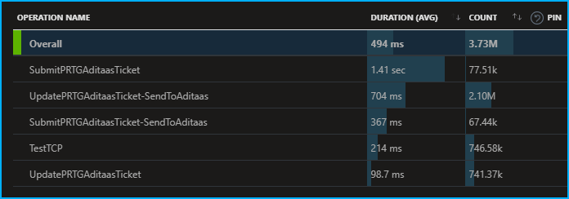


Functions in the Real World

Slide 10
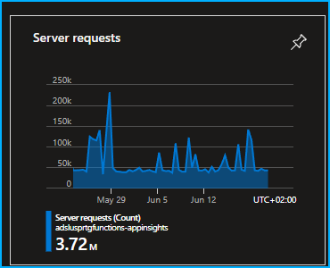
Functions in the Real World

Slide 11
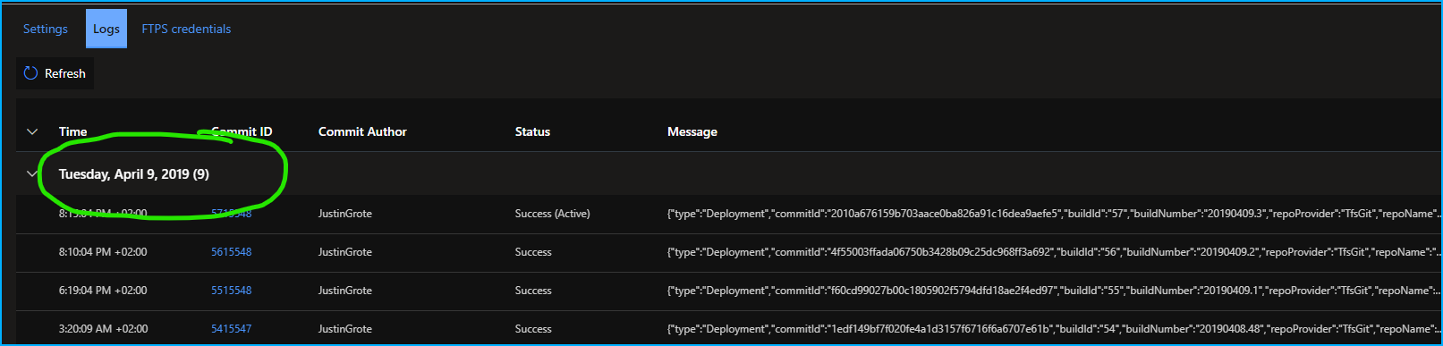
Functions in the Real World

Slide 12
Functions in the Real World

Slide 13
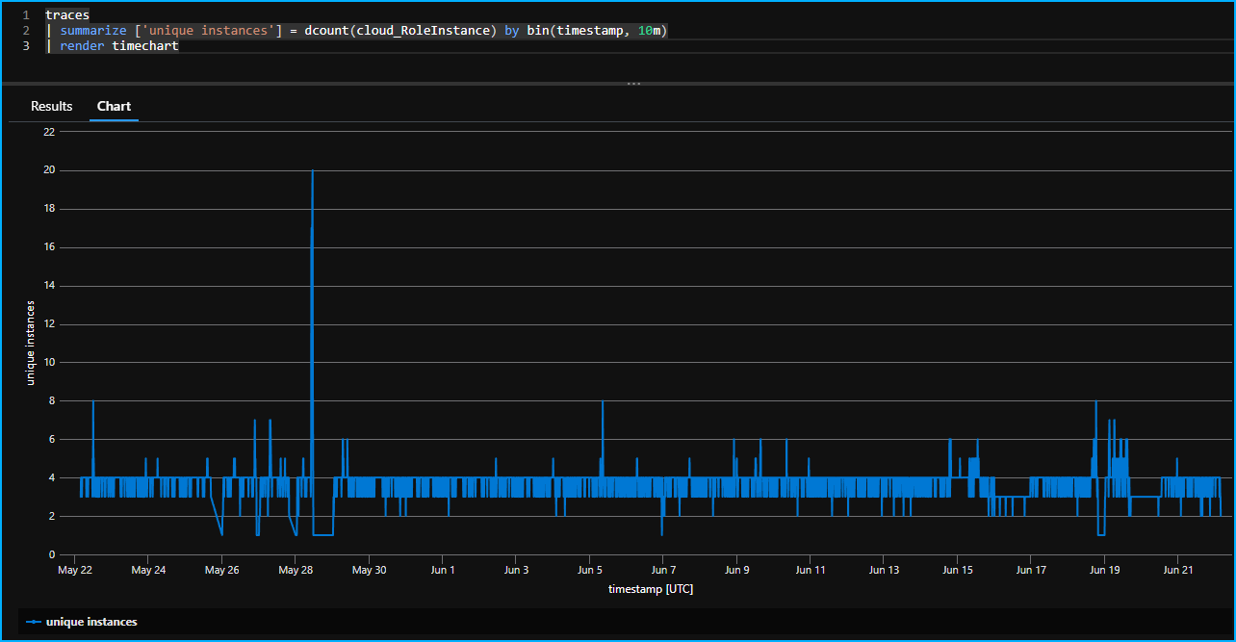
Serverless != No Servers

Slide 14
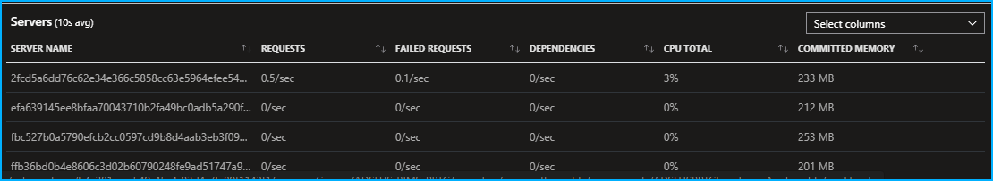
Cattle, Not Pets

Slide 15
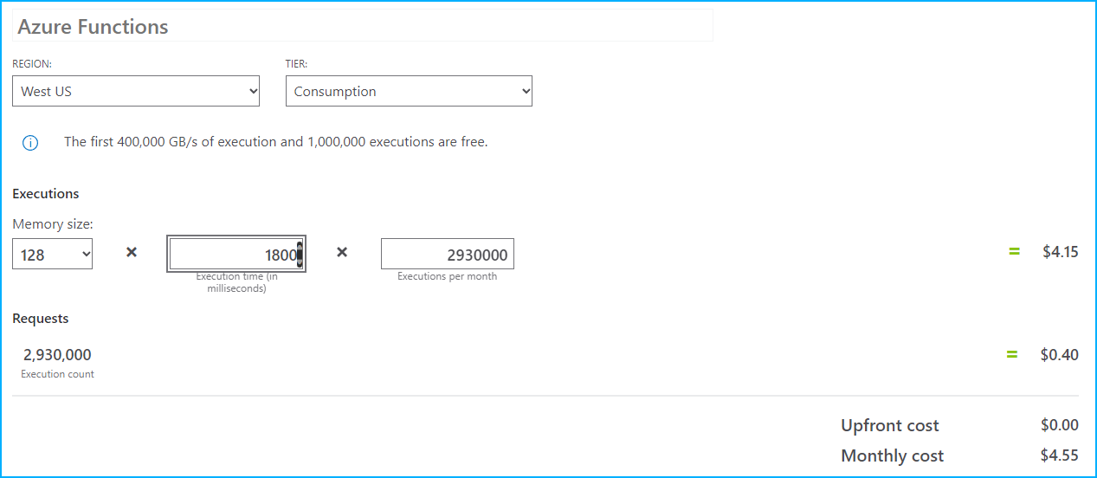
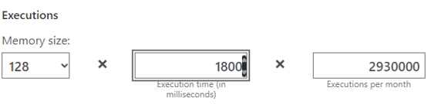
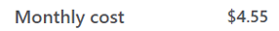
Functions in the Real World
🤯
🤯

Slide 16
Functions in the Real World
🤯
🤯

Slide 17

Func it, we’ll do it live!

Slide 18
References
https://github.com/PSConfEU/2022/JustinGrote

Slide 19
Q&A

Slide 20

Spock’s
Guide
To
Being
A Very
Good Boy
At
PSCONFEU

